Slide 1


LECTURE 7: Peripherals PIT TIMER
EMBEDDED SYSTEM COURSE

Slide 2
Learning Goals
Understanding basis concepts about timer, specifically in KL46 SoC.
Understanding on how to configure the PIT module in KL46.
Understanding on how to configure the Real Time Clock – RTC.
Notes:
Overview on KL46 Timer modules
Periodic Interrupt Timer (PIT) Module
Real Time Clock (RTC) Module

Slide 3
Table of contents
Overview on KL46 Timer modules
Periodic Interrupt Timer (PIT) Module
Real Time Clock (RTC) Module

Slide 4
Table of contents
Overview on KL46 Timer modules
Periodic Interrupt Timer (PIT) Module
Real Time Clock (RTC) Module

Slide 5
Overview on KL46 Timer modules
The KL46 supports following timer modules:
Timer/PWM Module (PWM): two to eight channel timer which supports input capture, output compare, and the generation of PWM signals to control electric motor and power management applications. The counter, compare and capture registers are clocked by an asynchronous clock that can remain enabled in low power modes.
Periodic Interrupt Timer (PIT)
Low power timer (LPTMR): can be configured to operate as a time counter with optional prescaler, or as a pulse counter with optional glitch filter, across all power modes, including the low-leakage modes. It can also continue operating through most system reset events, allowing it to be used as a time of day counter.
Real Time Clock (RTC)
This lecture only focuses on PIT, the remaining modules are advance topics and target on student’s self-study. Refer link.
Notes:
+ What application is TPM usually used for ?
+ To be define.

Slide 6
Table of contents
Overview on KL46 Timer modules
Periodic Interrupt Timer (PIT) Module
Real Time Clock (RTC) Module
Notes:
+ Basic elements of a timer
+ Differences in online and offline updating load value
+ Note for clearing w1c flag bit when there are other normal bits.

Slide 7
Periodic Interrupt Timer (PIT)
PIT is an counter that generates an output signal when it reaches a programmed count. The output signal is often used to trigger an interrupt
PIT may be one-shot or periodic.
One-shot timers will signal only once and then stop counting.
Periodic timers signal every time they reach a specific value and then restart, thus producing a signal at periodic intervals. Periodic timers are typically used to invoke activities that must be performed at regular intervals

Slide 8
Periodic Interrupt Timer (PIT) – cont.
Typical applications:
To implement a clock
To check user input periodically
To monitor environment changes
To switch between programs
Count how many cycles/times the MCU has been elapsed since last restart.

Slide 9
Periodic Interrupt Timer (PIT) – cont.
Simple explanation:
A timer is basically a counter of clock cycles.

Slide 10
Periodic Interrupt Timer (PIT) – cont.
Time Period
= (count + 1) × clock cycle time = (count + 1) / clock frequency
EX: The clock frequency is 50MHz.
The needed time period is 5.1ms.
What is the count value?
Notes:
256000

Slide 11
Periodic Interrupt Timer (PIT) – cont.
How to program a timer?
Set up count value
Check if the timer expires
Configure interrupt, if interrupt is to be used
Read current value (if supported)
Notes:
49999

Slide 12
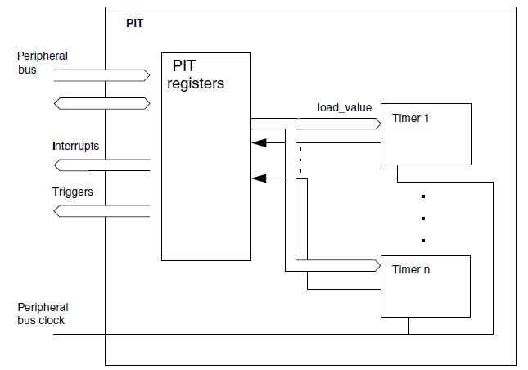
Periodic Interrupt Timer (PIT) – cont.
KL46 PIT Module
The KL46 PIT module is an array of two timers that can be used to raise interrupts and trigger DMA channels.
As its name: “Periodic timers” the KL46 PIT timer is automatically restart when counter reaching to zero
The KL46 PIT block diagram

Slide 13
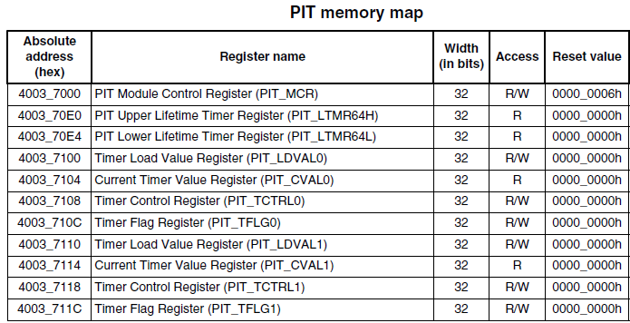
Periodic Interrupt Timer (PIT) – cont.
The KL46 PIT register descriptions

Slide 14
Periodic Interrupt Timer (PIT) – cont.
The KL46 PIT register descriptions
PIT Module Control Register (PIT_MCR) : enable/disable the PIT timer clock and control the timer when PIT enters debug mode
PIT Upper/Lower Lifetime Timer Register (PIT_LTMR64H PIT_LTMR64L): counting the MCU lifetime (number of cycle has been elapsed from last restart)
Timer Load Value Register (PIT_LDVALn): set timeout counter number
Current Timer Value Register (PIT_CVALn): indicate the current timer position
Timer Control Register (PIT_TCTRLn): configure the specific timer enable/disable, setup the chain mode, timer interrupt enable
Timer Flag Register (PIT_TFLG): holds that status of the timer interrupt flag.

Slide 15
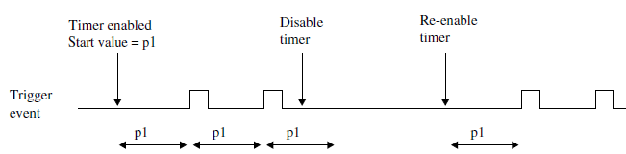
Periodic Interrupt Timer (PIT) – cont.
Some scenarios on setting the timer counter
The counter period can be restarted, by first disabling, and then enabling the timer with TCTRLn[TEN].

Slide 16
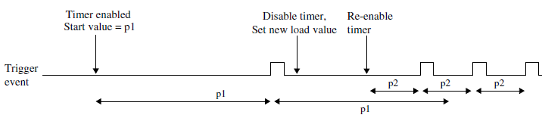
Periodic Interrupt Timer (PIT) – cont.
Some scenarios on setting the timer counter
The counter period of a running timer can be modified, by first disabling the timer, setting a new load value, and then enabling the timer again

Slide 17
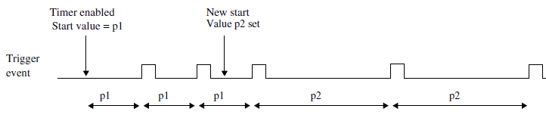
Periodic Interrupt Timer (PIT) – cont.
Some scenarios on setting the timer counter
It is also possible to change the counter period without restarting the timer by writing LDVAL with the new load value. This value will then be loaded after the next trigger event

Slide 18
Periodic Interrupt Timer (PIT) – cont.
Some scenarios on setting the timer counter
If we want to setup a timer with timeout period > maximum timer counter:
Expect timeout > 2³²/f_{PIT}
In this case we can consider to use the chain timer (timer2 counter will be started to count when timer1 counter reached to zero)

Slide 19
Periodic Interrupt Timer (PIT) – cont.
Some examples
The PIT clock has a frequency of 50 MHz.
Timer 1 creates an interrupt every 5.12 ms.
Timer 2 creates an interrupt every 30 ms.
// turn on PIT
PIT_MCR = 0x00;
// Timer 1
PIT_LDVAL1 = 0x0003E7FF; // setup timer 1 for 256000 cycles
PIT_TCTRL1 = TIE; // enable Timer 1 interrupts
PIT_TCTRL1 |= TEN; // start Timer 1
// Timer 2
PIT_LDVAL2 = 0x0016E35F; // setup timer 2 for 1500000 cycles
PIT_TCTRL2 |= TEN; // start Timer 2

Slide 20
Periodic Interrupt Timer (PIT) – cont.
Some examples
The PIT clock has a frequency of 100 MHz.
Two timer module are available
An interrupt shall be raised every 1 hour.
// turn on PIT
PIT_MCR = 0x00;
// Timer 1
PIT_LDVAL1 = 0x23C345FF;0x00000009; // setup timer 1 for 600 000 000 cycles
PIT_TCTRL1 = TIE; // enable Timer 1 interrupts
PIT_TCTRL1 |= TEN; // start Timer 1
// Timer 2
PIT_LDVAL3 = 0x00000009;; // setup timer 2 for 10 cycles
PIT_TCTRL2 = TIE; // enable Timer 2 interrupt
PIT_TCTRL2 |= CHN; // chain Timer 2 to Timer 1
PIT_TCTRL2 |= TEN; // start Timer 2

Slide 21
Table of contents
Overview on KL46 Timer modules
Periodic Interrupt Timer (PIT) Module
Real Time Clock (RTC) Module
Notes:
+ Why use RTC instead of PIT ?
+ Note for using RTC in KL46 FRDM board (no 32768 hz clock source)

Slide 22
Real Time Clock – RTC
In modern device today, almost has clock which can be display in LCD with time and date information.
The Real Time Clock – RTC is used to maintain and control the date & time which runs off its own battery.
The RTC also used to other functions including alarm and event scheduling.

Slide 23
Real Time Clock – RTC (con.t)
KL46 RTC Module
The RTC module features include:
32-bit seconds counter with roll-over protection and 32-bit alarm
16-bit prescaler with compensation that can correct errors between 0.12 ppm and 3906 ppm
Register write protection: Lock register requires POR or software reset to enable write access
1 Hz square wave output
The RTC remains functional in all low power modes and can generate an interrupt to exit any low power mode.

Slide 24
Real Time Clock – RTC (con.t)
KL46 RTC Module
Internal connection
MCG
SIM
Register access
clock
RTC OSC
Timer clock
RTC
NVIC
interrupt

Slide 25
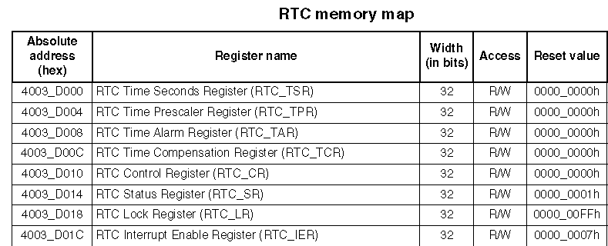
Real Time Clock – RTC (con.t)
KL46 RTC Module
Registers:
All registers must be accessed using 32-bit writes and all register accesses incur three wait states.
Write accesses to any register by non-supervisor mode software, when the supervisor access bit in the control register is clear, will terminate with a bus error.

Slide 26
Real Time Clock – RTC (con.t)
KL46 RTC Module – Step to configure the RTC
In system powered-up state
Configure the SIM for access to the RTC register block
/*enable the clock to SRTC module register space*/
SIM_SCGC6 = SIM_SCGC6_RTC_MASK;
After VBAT POR or software reset
Enable the oscillator
RTC_CR |= RTC_CR_OSCE_MASK;
The time invalid flag is set and must be cleared by writing the seconds register to a valid value
RTC_TSR = 0x00000005;
Enable the counter
RTC_SR |= RTC_SR_TCE_MASK;

Slide 27
Real Time Clock – RTC (con.t)
KL46 RTC Module – Step to configure the RTC
Using time compensation use the RTC_TCR register
Select compensation interval value (1 to 256)
Select time compensation register value (-127 to +128)
RTC_TCR = 0x0000_0100; //apply every 2 seconds
RTC_TCR |= 0x0000_0080; // add 128 cycles to the prescaler register
To lock the Status, Control, or Time Compensation Registers use the RTC Lock register (hard lock).
Can only be cleared on Vbat POR or software reset via RTC_CR
RTC_LR = 0x00000010; // lock SR, CR, and TCR. Will require VBAT POR

Slide 28
Summary
Understanding about the basic concepts regarding periodic timer and especially the KL46 PIT and RTC timer modules.
Understanding on how to setup a simple timer and a chain timer.
Understanding on how to setup a Real Time Clock

Slide 29

Question & Answer
Thanks for your attention !

Slide 30
Copyright
This course including Lecture Presentations, Quiz, Mock Project, Syllabus, Assignments, Answers are copyright by FPT Software Corporation.
This course also uses some information from external sources and non-confidential training document from Freescale, those materials comply with the original source licenses.

